Slide 1
Lockdown Heroes

Slide 2
Lockdown Heroes
Topic is going to be a little different this week.
Hopefully, this is the last ever topic we’ll do at home, or in school as a key worker’s child. So I thought it would be a good idea to celebrate all of the heroes that have helped get us through. Although the pandemic is not over and there is still a long way to go, we can be hopeful that this part is over and we can get back to normal school next week.
So the most obvious place to start this week of celebrations is with the NHS. The true front line heroes of this pandemic.

Slide 3
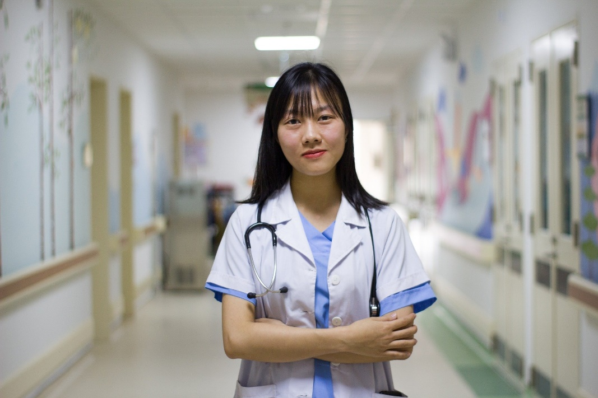
What Is the NHS?
The NHS stands for the UK’s National Health Service.
People who work in the NHS keep people healthy. They help those in the UK who are feeling unwell or are injured.

Slide 4
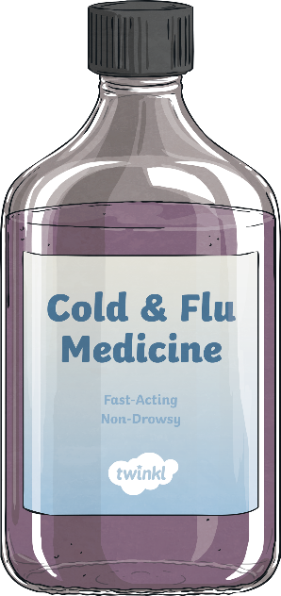
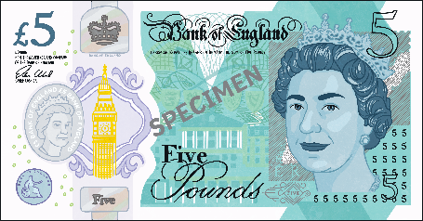
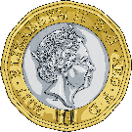
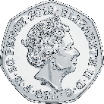
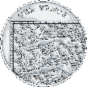
Life Before the NHS
We haven’t always had a National Health Service which is available for all in the way it is today.
Before having the NHS, only wealthy people could afford to go to hospital or get medical help.
Every visit to a doctor or operation would cost the person money. If the person could not afford it, they did not get the medicine or the treatment.

Slide 5
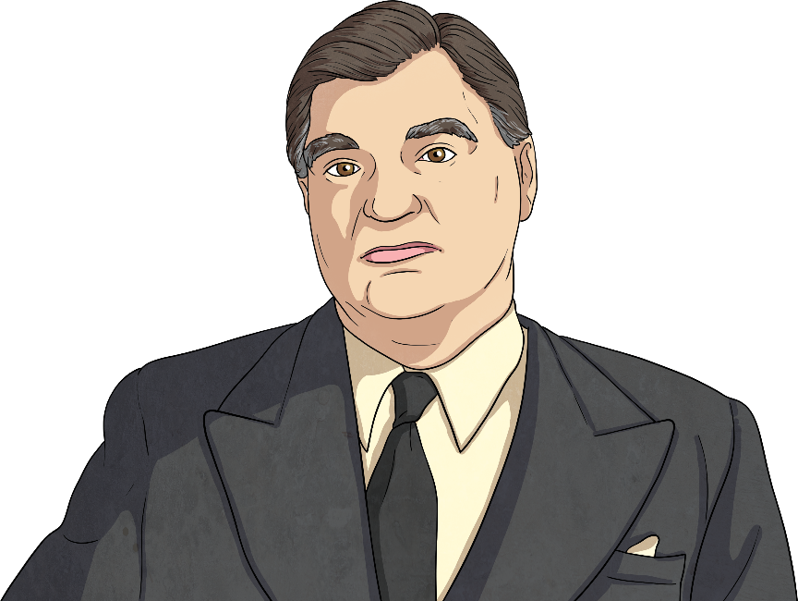
Aneurin Bevan
Aneurin Bevan decided to change things.
Aneurin Bevan was a Welsh Labour Party politician.
After the Second World War, Aneurin Bevan was chosen as the Minister of Health in the Labour government.
He started the National Health Service on 5th July 1948.
He wanted a system which provided medical care which was free at point-of-need for everyone within the UK, regardless of wealth.

Slide 6
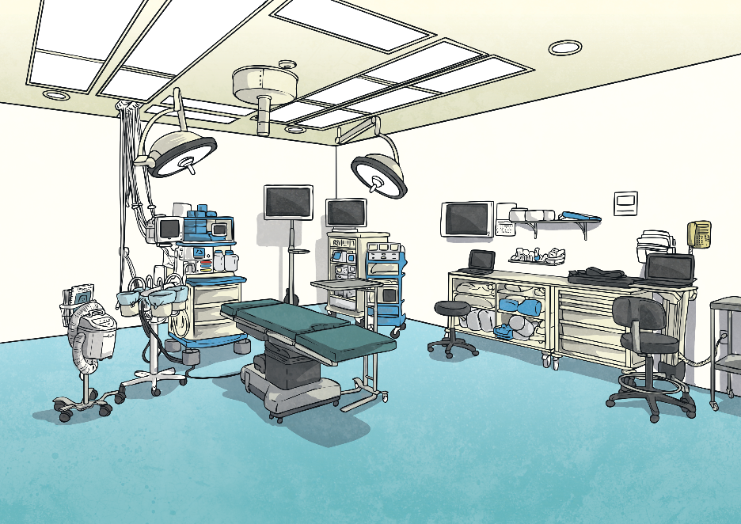
How Does It Work?
Today, the NHS allows every person in the United Kingdom to access free medical help, treatment and advice. Unlike in many other countries, there is no bill to pay at the end of your treatment.
The money for the NHS comes from the Government’s Department of Health and Social Care, and most of this money comes from taxes which working people pay every month. Some of the money comes from what is charged for prescriptions and dental care.

Slide 7
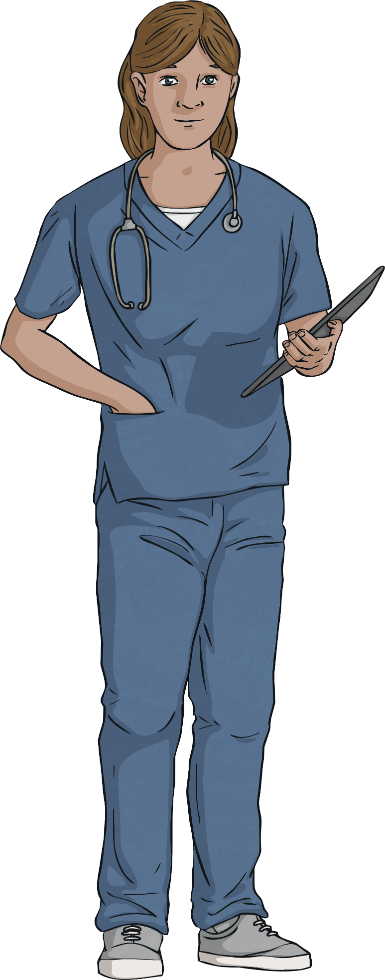
How Does It Work?
The money for the NHS is spent in different ways, including:
Day-to-day expenses such as staff wages and paying for medicines
Building new hospitals and paying for new computers and equipment
Giving training to doctors, nurses and other staff
Paying for public health campaigns to help people live more healthily
Did you know…?
As the population increases and people are living longer, many hospital trusts across the country are spending more money than is coming in. This means the NHS is currently under a lot of pressure.

Slide 8
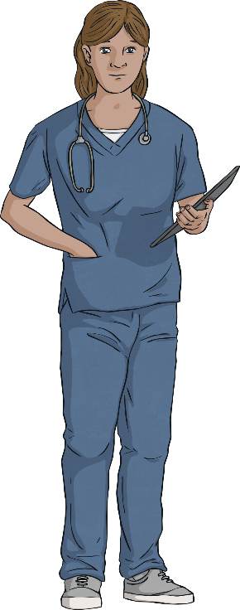
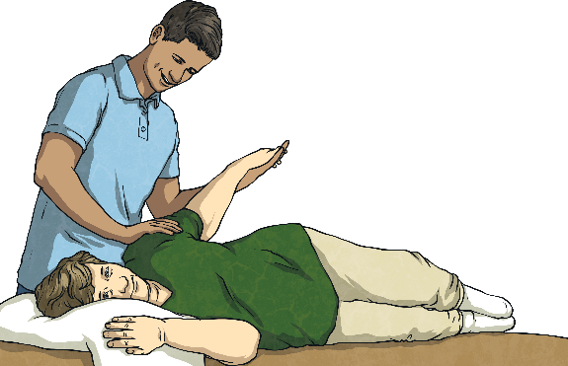
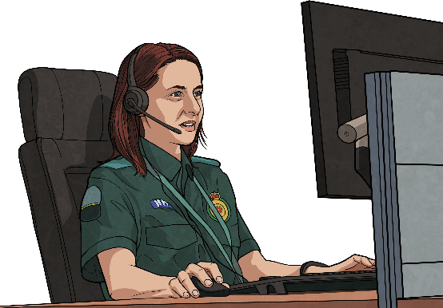
NHS Staff
There are many different people who work within the NHS.
Some you might immediately think of and others you might not have thought of at first.
Every single person and role is important for the NHS to work together as a system of health for the country.
nurses
doctors
Nurses care for patients. They might take your temperature, clean a wound or give you an injection, such as a vaccination.
Doctors see patients in doctor’s surgeries and hospitals. They diagnose the problem and can prescribe medicine. Some doctors perform surgery.
ambulance service team
allied health professionals
Telephone operators answer people’s 999 calls and work out what help is needed in each emergency. Paramedics respond and give people first aid. They use an ambulance to get patients to hospital as quickly as possible.
These people work with patients by helping them to be rehabilitated or providing treatment, e.g. hospital chaplains, physiotherapists.

Slide 9
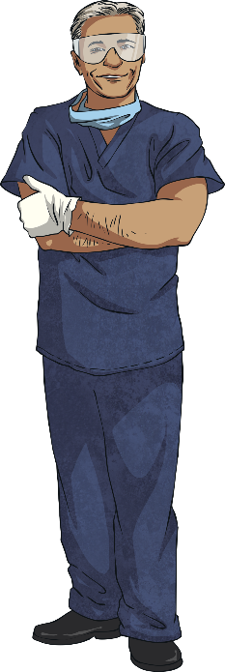
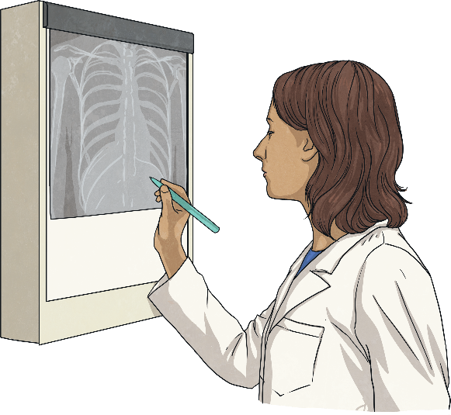
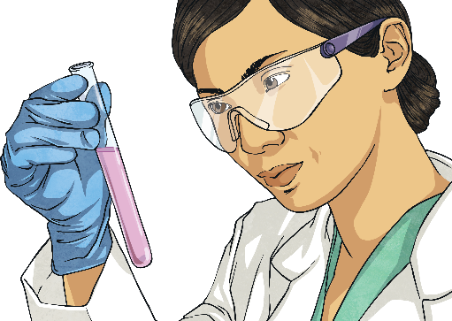
NHS Staff
There are many different people who work within the NHS.
Some you might immediately think of and others you might not have thought of at first.
Every single person and role is important for the NHS to work together as a system of health for the country.
dental team
health informatics
Staff at a dental surgery work together to keep your teeth clean and healthy. A dental nurse might polish your teeth. A dentist might give your tooth a filling or even take a tooth out. The office staff book all the appointments.
These people get information to the right people at the right time through electronic records or spotting trends in diseases and treatments. They help other people make decisions.
healthcare scientists
NHS scientists look for ways to help save lives and make lives better through research.

Slide 10
NHS Staff
There are many different people who work within the NHS.
Some you might immediately think of and others you might not have thought of at first.
Every single person and role is important for the NHS to work together as a system of health for the country.
management
pharmacists
The NHS managers have to make sure the system runs smoothly. They use their budget to work out how to spend NHS money. They allocate staff to each hospital, and more.
Pharmacists get medicine ready for patients. They give people advice on taking the right medicine to recover.
midwives
Midwives care for pregnant women. They help to deliver the baby and to keep the mother and baby healthy afterwards.

Slide 11
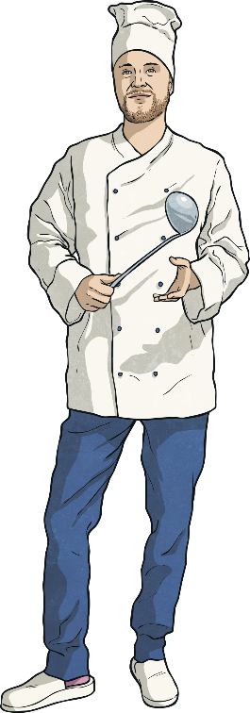
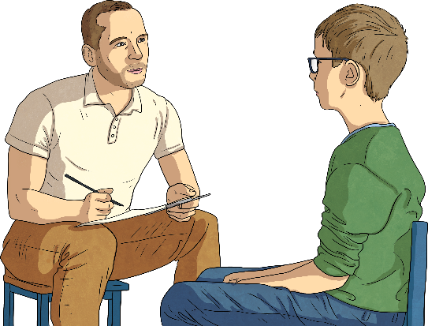
NHS Staff
There are many different people who work within the NHS.
Some you might immediately think of and others you might not have thought of at first.
Every single person and role is important for the NHS to work together as a system of health for the country.
psychological professionals
wider healthcare team
These NHS workers support people’s minds and mental wellbeing.
There are lots of people needed to make the NHS work, such as cleaners, porters, chefs, building staff and more.
Did you know
about all these different jobs within the NHS?
public health team
Which jobs were
new to you?
The public health team are in charge of making sure that we know how to live healthy lives and what to do if we are unwell.

Slide 12
What is PPE?
P – Personal P – Protective E – Equipment
Why is PPE important for the NHS?
PPE is important to keep NHS workers safe in the workplace or on home visits when they are likely to come into contact with suspected or confirmed diseases or bacteria. Healthcare workers may be required to use equipment, follow procedures or instructions, take part in training or work under supervision to ensure work is carried out safely.

Slide 13
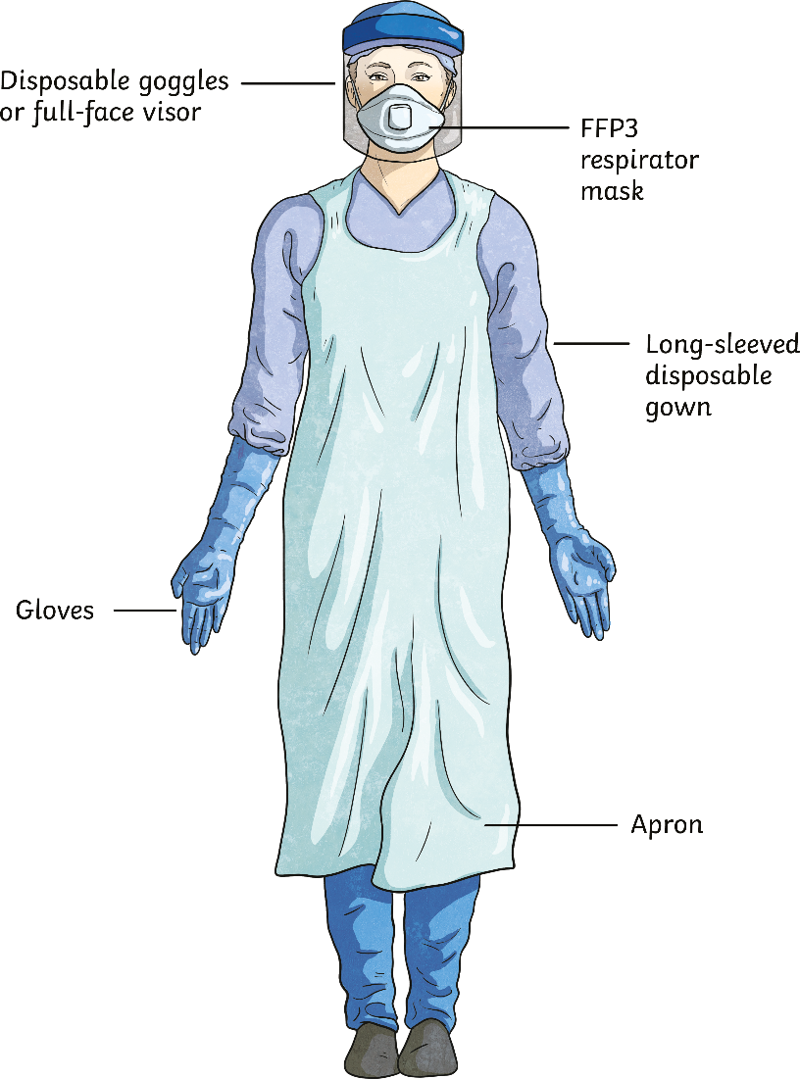
Types of PPE
Lungs Where necessary, a filtered facepiece or respirator may be worn to prevent gases, dust, vapours or bacteria entering the lungs.
It’s important to note that to be effective, these must be filtered.
Click each arrow to show information about PPE for each area.
Eyes Where necessary, safety glasses or goggles or a face shield may be worn to prevent flying particles or bacteria entering the eyes.
Hands and Arms Where necessary, gloves or sleeves that cover part or all of the arm may be worn to prevent contact with hazards such as extreme temperatures, chemicals, radiation or bacteria touching the skin.
Whole Body Where necessary, aprons, boiler suits or overalls may be worn to prevent the wearer against heat, contaminated fluid or dust or the impact of harmful objects.

Slide 14
NHS Timeline
1948 – The NHS was created (launched by Aneurin Bevan).
1952 – People had to start paying a small fee to have medicine prescribed.
1958 – The first big vaccination programme started, protecting lots of people from diseases called polio and diphtheria.
1962 – The Hospital Plan started, ensuring that there were enough hospitals to treat everyone.
1968 – The UK’s first heart transplant happened.
1972 – CT scanners were used for the first time to create detailed images of bodies, helping to diagnose injuries and illnesses.
1994 – The organ donor register was created, meaning that people could volunteer to donate their organs after they died.
2006 – Patient choice was created (where patients could choose which hospital they attend).
2018 – The NHS turned 70.

Slide 15
NHS Heroes
As you can see, every single member of the NHS has been a hero long before the pandemic struck, but this last year has well and truly cemented their place as national treasures.
At the start of the pandemic, the rainbow become a symbol of the NHS as a way of showing everyone’s support and appreciation.

Slide 16
Your tasks
There are three different tasks, feel free to choose which one (or two or three)
Task 1
Create a rainbow. Think creatively, think outside the box. You can do this however you want, the only limit is your imagination.
Task 2
Write a letter to thank NHS staff for all they have done. This could be an open letter to the whole of the NHS or a letter specifically to someone you know who works for the NHS. If you do not know anyone personally, I can help you out.
Task 3
Design an NHS superhero. Think about what they would look like, what they would be wearing and a superhero logo.

